Slide 1
Object-Oriented Programming
Topic 9: Logic expression normalizer
Lecturer: Prof. Nguyen Thi Thu Trang

Slide 2
MEMBER
Le Quang Hieu
20210335
Pham Trung Hieu 20214899
HOANG MINH HOANG
20214900
Phan Duc Hung 20214903
1. UI
2. Solver
1. Algorithm
1. Algorithm
1. Solver
2. Algorithm

Slide 3
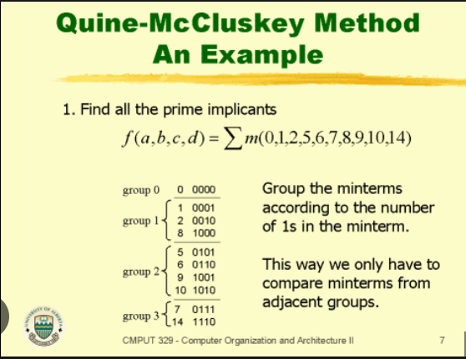
Problem statement
This application is a logic expression normalizer using the Quine-McCluskey algorithm. It takes a Boolean expression as an input.
User can choose number of variables, types of input, values input and types of output.
Application outputs: The minimal Boolean expression with visualization
Requirement

Slide 4
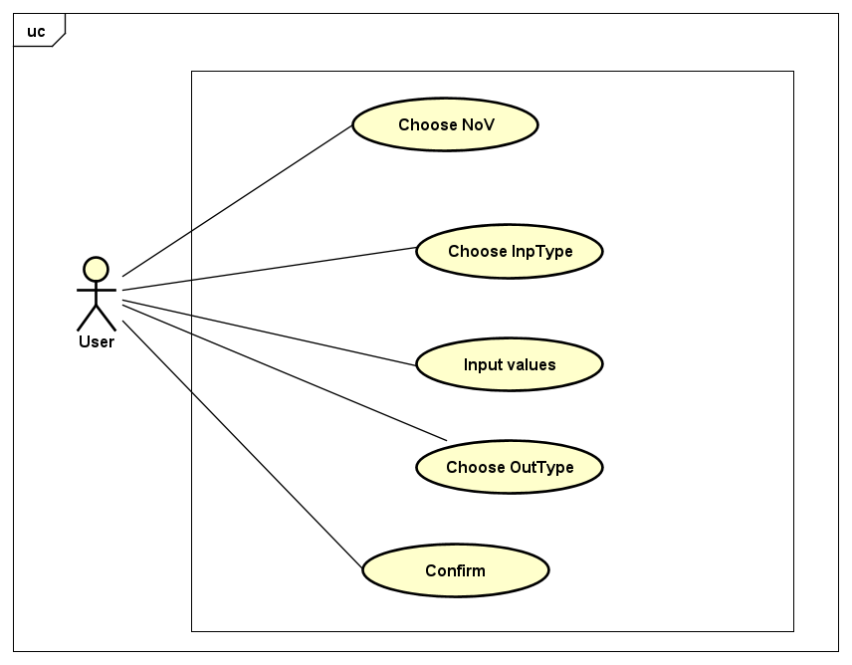
Use case diagram

Slide 5
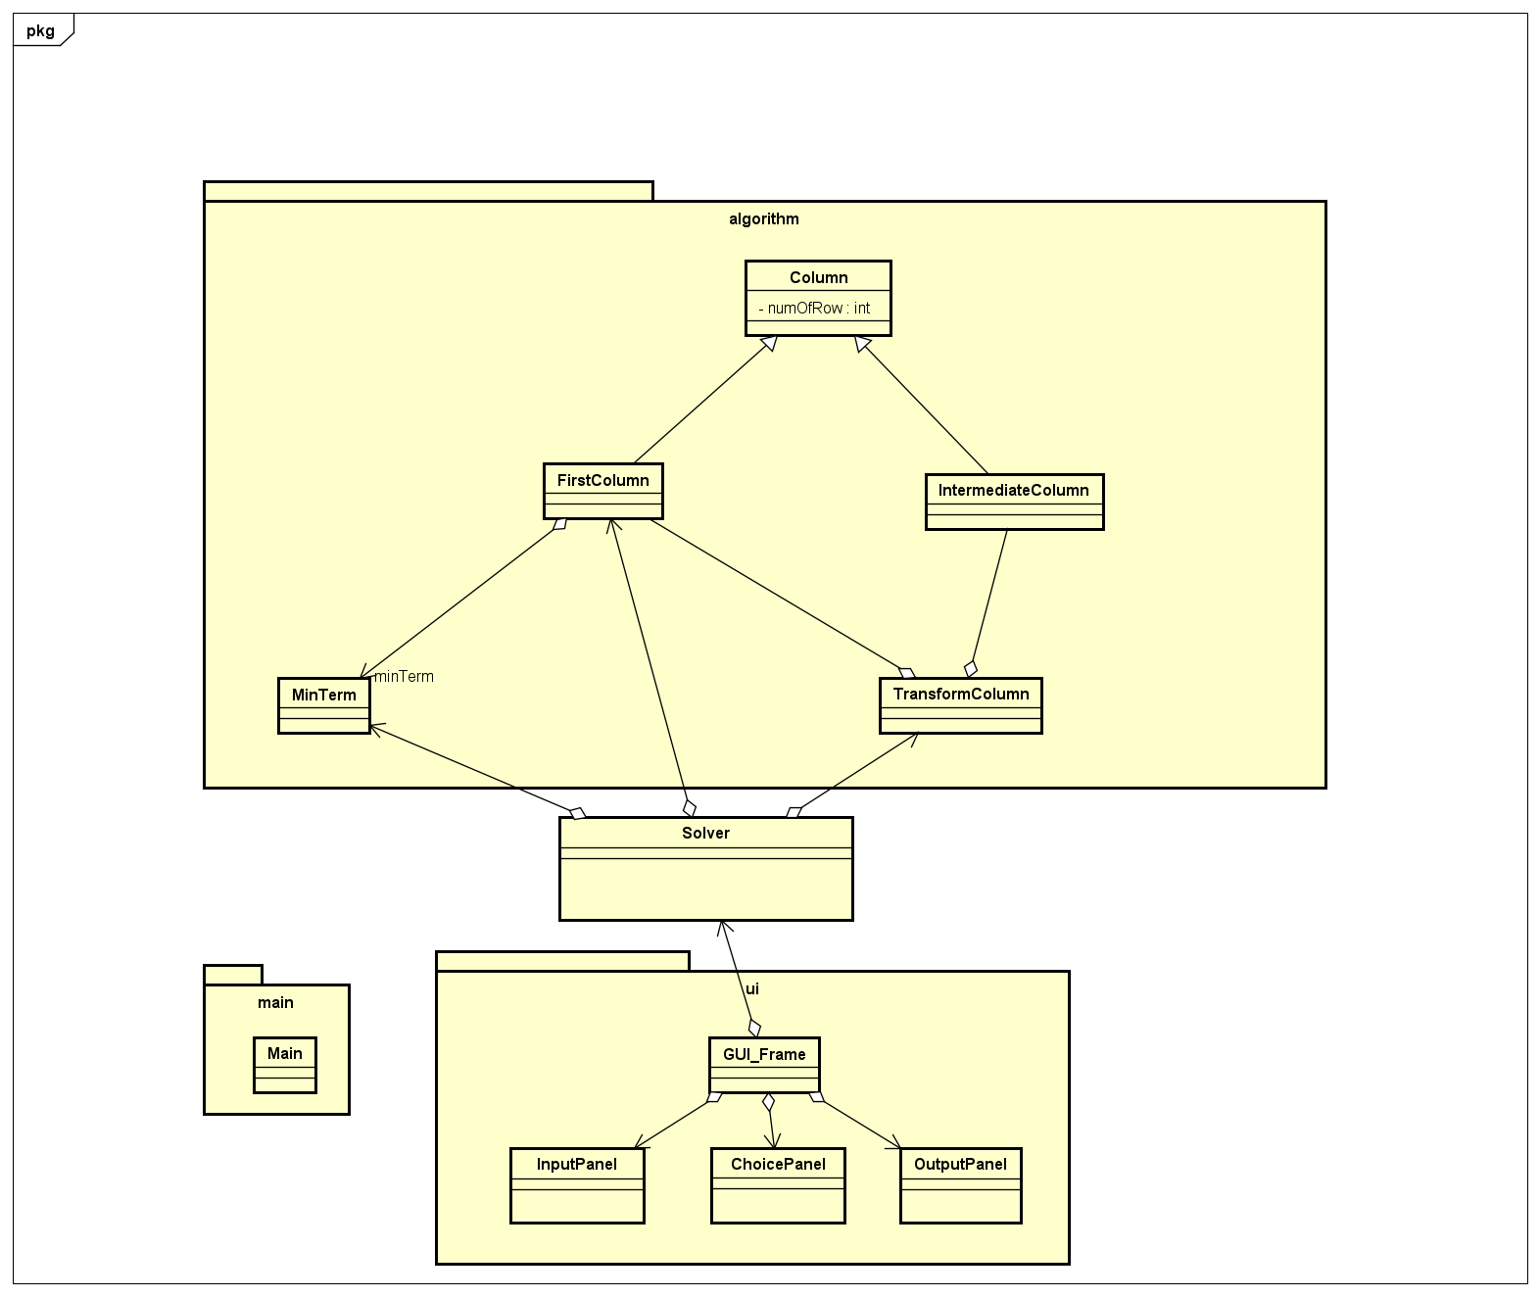
Class Diagram
General class diagram

Slide 6
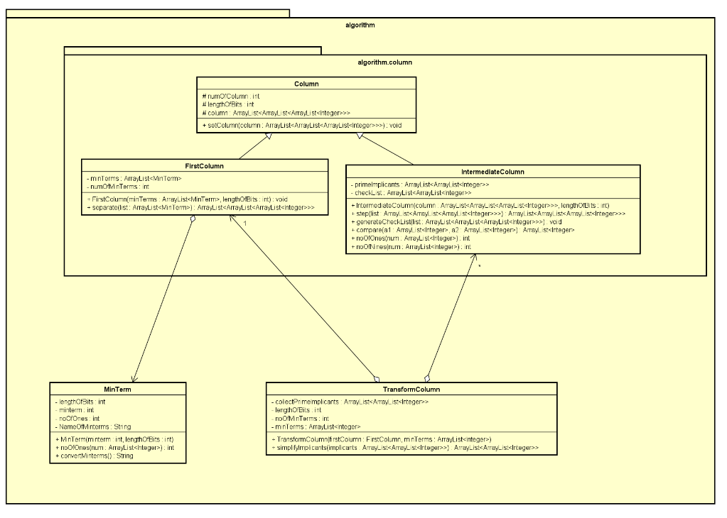
Algorithm Class Diagram
Algorithm class diagram

Slide 7
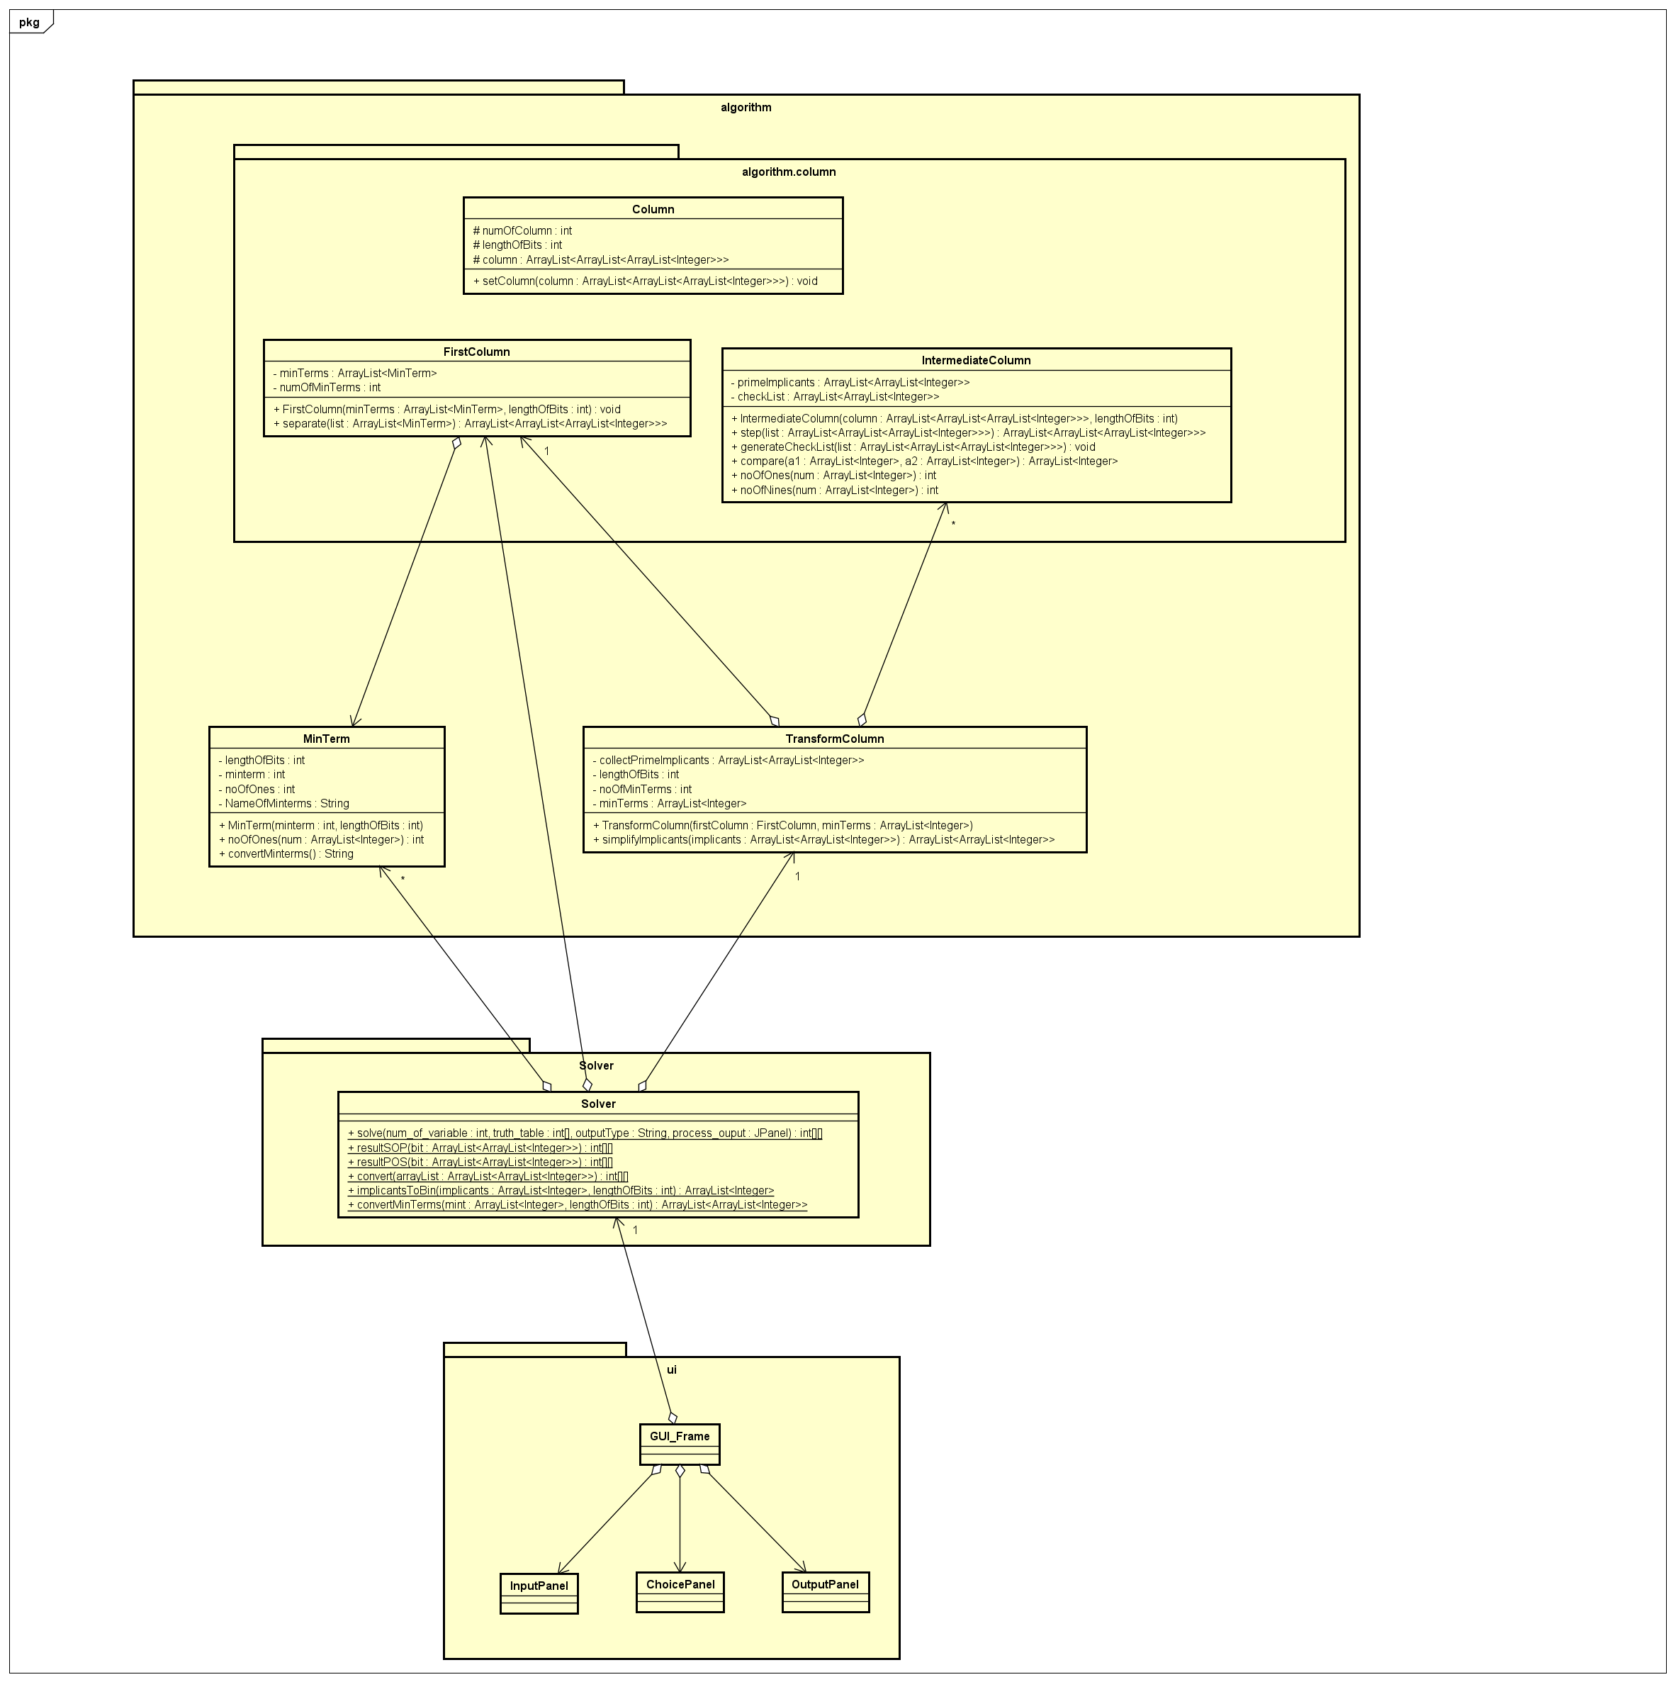
Solver Diagram
Solver Diagram

Slide 8
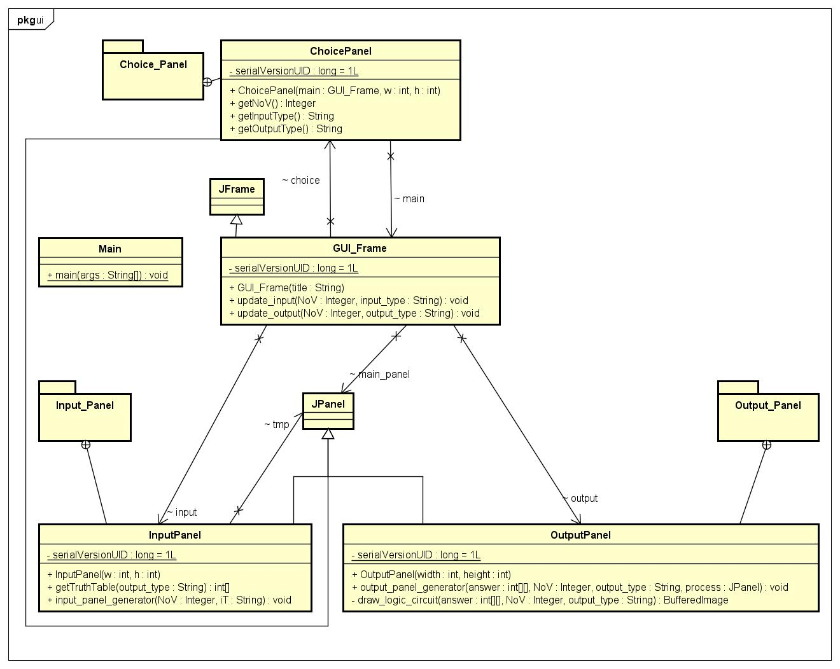
User Interface Diagram
User Interface Diagram

Slide 9
Inheritance
Since FirstColumn, IntermediateColumn have the same attribute numOfColumn, lengthOfBits and column as well as the methods like getNumOfColumn, getLengthOfBits, getColumn,.... So that we create the column class for FirstColumn and IntermediateColumn to inherit.

Slide 10
Aggregation
As we can see in the Solver Class Diagram, the Solver contains many MinTerm, added to an ArrayList<MinTerm>, a FirstColumn and a TransfromColumn. The FirstColumn also contains an ArrayList<MinTerm>. The TransformColumn contains many IntermediateColumn.
In GUI_Frame, we contain 3 panels: ChoicePanel, InputPanel, OutputPanel. Also each part can process its own property, while communicating with each other using only necessary information.

Slide 11
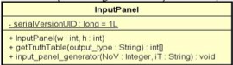
Encapsulation
Inside InputPanel, the data is hidden from outer interference, the JPanel ‘tmp’ that contains user input can only be accessed or modified by method: input_panel_generator and getTruthTable.

Slide 12
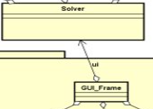
Dependency
As we can see in Solver Class Diagram, the GUI_Frame will create a OutputPanel which takes value as the return of a method from Solver. Also, the TransformColumn takes FirstColumn to construct.

Slide 13
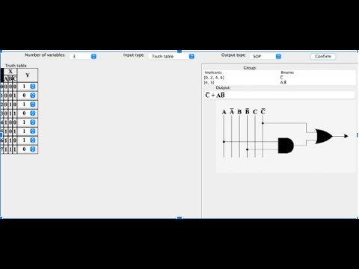
DEMO

Slide 14
THANK YOU FOR LISTENING

